Slide 1
Lecture 13: Singular Value Decomposition (SVD)
Junghoo “John” Cho
UCLA

Slide 2
Summary: Two Worlds
basis vectors
World of vectors
Vector $\vec{v}$
Linear transformation
$T\left(a\vec{x}+b\vec{y}\right)=aT\left(\vec{x}\right)+bT\left(\vec{y}\right)$
Orthogonal Stretching
Stretching factor
Stretching direction
Rotation
Stretching + Rotation
World of numbers
$1D: \left(1, 2, 0\right)$ vector
$2D: \left(\begin{matrix}1 & 3 & ⋯ \\ 2 & ⋱ & ⋮ \\ ⋮ & 0 & 2\end{matrix}\right)$ matrix
Symmetric matrix
Eigenvalue
Eigenvector
Orthonormal matrix
1:1 mapping (=isomorphic)

Slide 3
Singular Value Decomposition (SVD)
Any matrix $T$ can be decomposed to $T=Q_{1}DQ_{2}^{T}$ where $D$ is a diagonal matrix and $Q_{1}$ and $Q_{2}$ are orthonormal matrix
Singular values: diagonal entries in $D$
Example
Q: What is this transformation? What does SVD mean?
$$\left(\begin{matrix}\frac{9\sqrt{2}}{5} & \frac{\sqrt{2}}{10} \\ \frac{3\sqrt{2}}{5} & \frac{17\sqrt{2}}{10}\end{matrix}\right)$$
$=\left(\begin{matrix}\frac{1}{\sqrt{2}} & −\frac{1}{\sqrt{2}} \\ \frac{1}{\sqrt{2}} & \frac{1}{\sqrt{2}}\end{matrix}\right)\left(\begin{matrix}3 & 0 \\ 0 & 2\end{matrix}\right)$ $\left(\begin{matrix}\frac{4}{5} & \frac{3}{5} \\ −\frac{3}{5} & \frac{4}{5}\end{matrix}\right)$

Slide 4
Singular Value Decomposition (SVD)
Q: What does $Q_{2}^{T}$ mean?
$T=Q_{1}DQ_{2}^{T}=\left(\begin{matrix}\frac{1}{\sqrt{2}} & −\frac{1}{\sqrt{2}} \\ \frac{1}{\sqrt{2}} & \frac{1}{\sqrt{2}}\end{matrix}\right)\left(\begin{matrix}3 & 0 \\ 0 & 2\end{matrix}\right)\left(\begin{matrix}\frac{4}{5} & \frac{3}{5} \\ −\frac{3}{5} & \frac{4}{5}\end{matrix}\right)$
Change of coordinates! New basis vectors are (4/5, 3/5) and (-3/5, 4/5)!
Q: What does $Q_{1}$mean?
Q: What does $D$ mean?
Rotation! Rotate first basis vector (4/5, 3/5) to (1/$\sqrt{2}$, 1/$\sqrt{2}$) second basis vector (-3/5, 4/5) to (-1/$\sqrt{2}$, 1/$\sqrt{2}$)
Orthogonal stretching! Stretch x3 along first basis vector (4/5, 3/5) Stretch x2 along second basis vector (-3/5, 4/5)!
SVD shows that any matrix (= linear transformation) is essentially a orthogonal stretching followed by a rotation

Slide 5
What about Non-Square Matrix $T$?
Q: When $T$is an $n×m$ matrix, what are dimensions of $Q_{1}, D, Q_{2}^{T}$? $(T) = {(Q}_{1}) (D) (Q_{2}^{T})$
For non-square matrix $T$, $D$ becomes a non-square diagonal matrix
When $n>m$ When $n<m$ $D=\left(\begin{matrix}d_{1} & 0 \\ 0 & d_{2} \\ 0 & 0 \\ ⋮ & ⋮\end{matrix}\right)$ $D=\left(\begin{matrix}d_{1} & 0 & 0 & ⋯ \\ 0 & d_{2} & 0 & ⋯\end{matrix}\right)$
$$m$$
$$n$$
$$m$$
$$m$$
$$n$$
$$n$$
$$n$$
$$m$$
“dimension padding”
Covert 2D to 3D by adding
a third dimension, for example
“dimension reduction” Convert 3D to 2D by discarding
the third dimension, for example

Slide 6
Computing SVD
Q: How can we perform SVD?
$T=Q_{1}DQ_{2}^{T}$
$T^{T}T={{(Q}_{1}DQ_{2}^{T})}^{T}\left(Q_{1}DQ_{2}^{T}\right)=\left(Q_{2}D^{T}Q_{1}^{T}\right)\left(Q_{1}DQ_{2}^{T}\right)=Q_{2}D^{T}DQ_{2}^{T}$
Q: What kind of matrix is $T^{T}T$?
$T^{T}T$ is a symmetric matrix
Orthogonal stretching
Diagonal entries of $D^{T}D \sim { D}^{2}$ are eigenvalues (i.e., stretching factor)
Columns of $Q_{2}$ are eigenvectors (i.e., stretching direction)
We can compute $Q_{2}$of $T=Q_{1}DQ_{2}^{T}$ by computing eigenvectors of $T^{T}T$
Similarly $Q_{1}$ is the eigenvectors of ${TT}^{T}$
$D \sim \sqrt{D^{T}D}$ or $\sqrt{DD^{T}}$
SVD can be done by computing eigenvalues and eigenvectors of T^{T}T and TT^{T}

Slide 7
Example: SVD
Q: What kind of linear transformation is $T$?
$$T=\left(\begin{matrix}\frac{3}{\sqrt{2}} & −2\sqrt{2} & \frac{1}{\sqrt{2}} \\ \frac{3}{\sqrt{2}} & −2\sqrt{2} & −\frac{1}{\sqrt{2}} \\ \frac{12}{5} & \frac{9}{5} & 0\end{matrix}\right)$$
$$=\left(\begin{matrix}\frac{1}{\sqrt{2}} & 0 & \frac{1}{\sqrt{2}} \\ \frac{1}{\sqrt{2}} & 0 & −\frac{1}{\sqrt{2}} \\ 0 & 1 & 0\end{matrix}\right)\left(\begin{matrix}5 & 0 & 0 \\ 0 & 3 & 0 \\ 0 & 0 & 1\end{matrix}\right)\left(\begin{matrix}\frac{3}{5} & −\frac{4}{5} & 0 \\ \frac{4}{5} & \frac{3}{5} & 0 \\ 0 & 0 & 1\end{matrix}\right)$$

Slide 8
Summary: Two Worlds
basis vectors
World of vectors
Vector $\vec{v}$
Linear transformation
$T\left(a\vec{x}+b\vec{y}\right)=aT\left(\vec{x}\right)+bT\left(\vec{y}\right)$
Orthogonal Stretching
Stretching factor
Stretching direction
Rotation
Stretching + Rotation
World of numbers
$1D: \left(1, 2, 0\right)$ vector
$2D: \left(\begin{matrix}1 & 3 & ⋯ \\ 2 & ⋱ & ⋮ \\ ⋮ & 0 & 2\end{matrix}\right)$ matrix
Symmetric matrix
Eigenvalue
Eigenvector
Orthonormal matrix
Singular value decomposition
1:1 mapping (=isomorphic)

Slide 9
SVD: Application
Rank-$k$ approximation
Sometimes we may want to “approximate” a large matrix as multiplication of two smaller matrices
Q: Why?
$$m$$
$$k$$
$$m$$
$$k$$
=
X
$$n$$
$$n$$

Slide 10
Rank-$k$ Approximation
Q: How can we “decompose” a matrix into multiplication of two matrices of rank-$k$ in the best possible way?
Minimize the “L2 difference” (= Frobenius norm) between the original matrix and the approximation

Slide 11
SVD as Matrix Approximation
$T=\left(\begin{matrix}1/\sqrt{2} & 0 & 1/\sqrt{2} \\ 1/\sqrt{2} & 0 & −1/\sqrt{2} \\ 0 & 1 & 0\end{matrix}\right)\left(\begin{matrix}100 & 0 & 0 \\ 0 & 10 & 0 \\ 0 & 0 & 0.1\end{matrix}\right)\left(\begin{matrix}3/5 & −4/5 & 0 \\ 4/5 & 3/5 & 0 \\ 0 & 0 & 1\end{matrix}\right)$
Q: If we want to reduce the rank of $T$ to 2, what will be a good choice?
The best rank-$k$ approximation of any matrix $T$ is to keep the first-$k$ entries of its SVD.
Minimizes L2 difference between the original and the rank-$k$ approximation

Slide 12
SVD Approximation Example: 1000 x 1000 matrix with (0…255)
62 | 60 | 58 | 57 | 58 | 57 | 55 | 53 | 55 | 54
61 | 60 | 58 | 57 | 57 | 57 | 55 | 53 | 55 | 54
61 | 59 | 58 | 57 | 57 | 56 | 55 | 54 | 55 | 55
59 | 59 | 58 | 57 | 57 | 56 | 55 | 54 | 56 | 55
58 | 58 | 58 | 57 | 56 | 55 | 55 | 55 | 56 | 55
57 | 58 | 58 | 57 | 56 | 55 | 55 | 56 | 56 | 55
56 | 57 | 58 | 57 | 55 | 54 | 55 | 56 | 56 | 56
56 | 57 | 58 | 57 | 55 | 54 | 55 | 56 | 56 | 56
59 | 58 | 57 | 56 | 55 | 56 | 56 | 57 | 59 | 57
58 | 58 | 57 | 57 | 56 | 56 | 56 | 56 | 58 | 57
57 | 57 | 57 | 57 | 57 | 57 | 56 | 56 | 57 | 56
56 | 57 | 57 | 58 | 58 | 57 | 56 | 55 | 56 | 56
Notes:
12

Slide 13
Image of original matrix 1000x1000
Notes:
13

Slide 14
SVD. Rank 1 approximation
Notes:
14

Slide 15
SVD. Rank 10 approximation
Notes:
15

Slide 16
SVD. Rank 100 approximation
Notes:
16

Slide 17
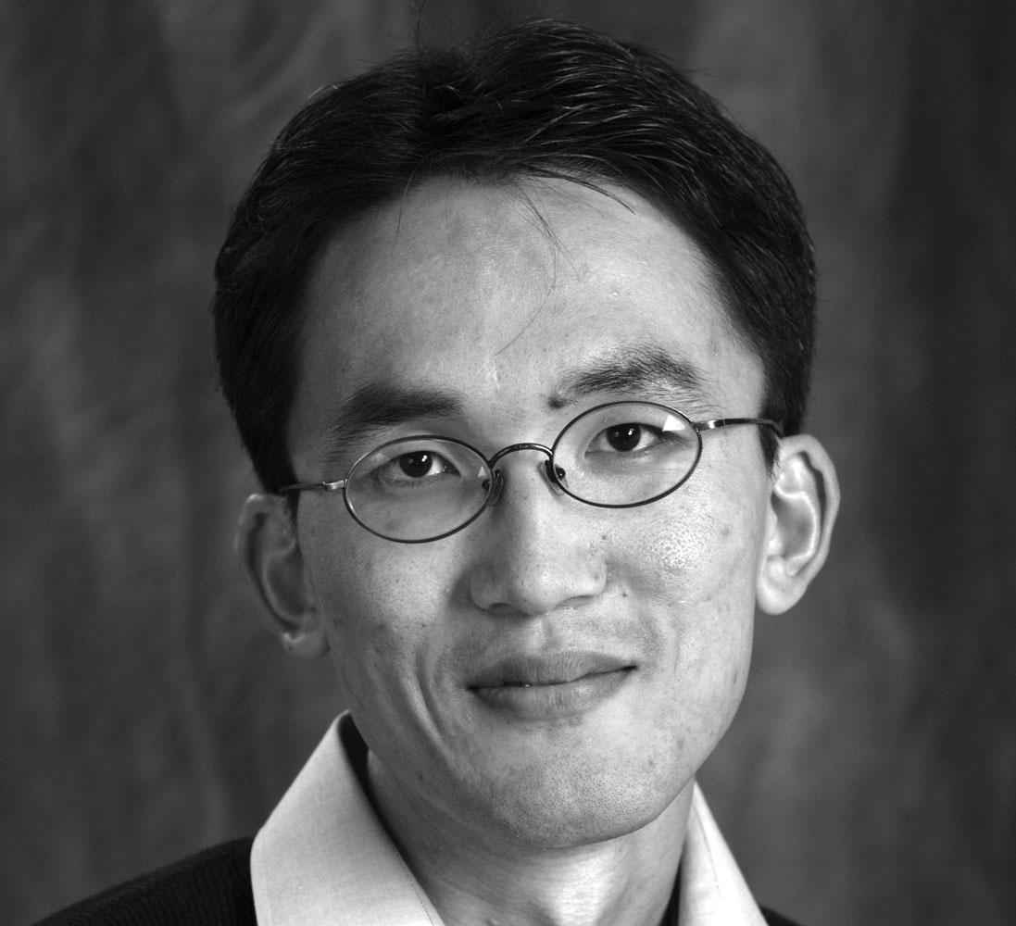
Original vs Rank 100 approximation
Q: How many numbers do we keep for each?
Notes:
17

Slide 18
Dimensionality Reduction
A data with large dimension
Example: 1M users with 10M items. 1M x 10M matrix
Q: Can we represent each user with much fewer dimensions, say 1000, without losing too much information?

